Slide 1

Agricultural Silo Selection and Elevator System
Kurt Goldstein
Kayann Januchowski
Keith Dugas
Bill Epperson

Slide 2
Product Overview
An agricultural silo management system; used to manage and direct silos to be filled by a grain elevator
The system chooses a silo to contain incoming grain shipments or to fulfill outgoing grain orders with oversight by an elevator manager
Silos chosen will be based on criteria entered by the elevator manager
The system will house data regarding silo and grain status and be able to produce reports

Slide 3
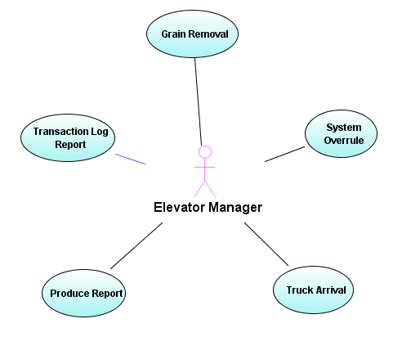

Use Case Diagram

Slide 4
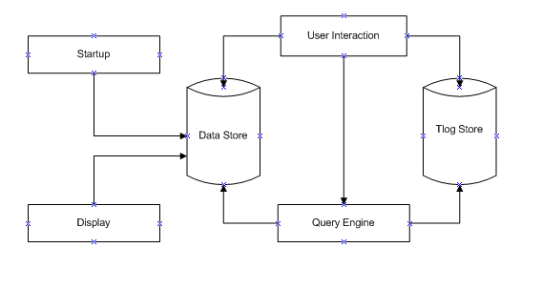
Candidate A Decomposition

Slide 5
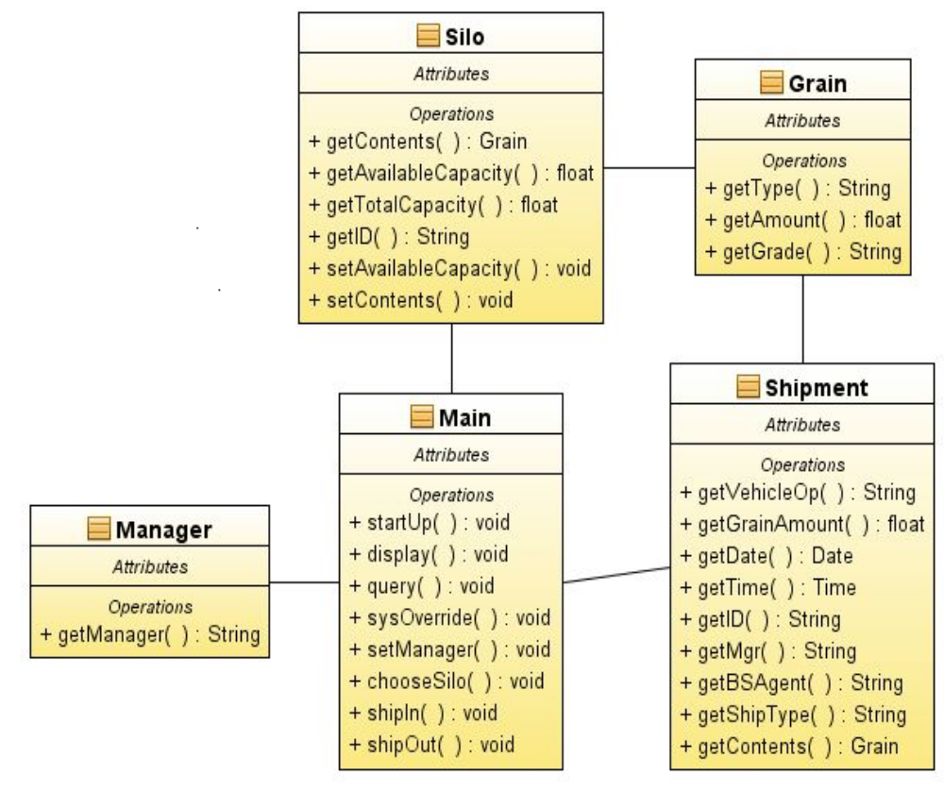
Candidate A Class Model

Slide 6
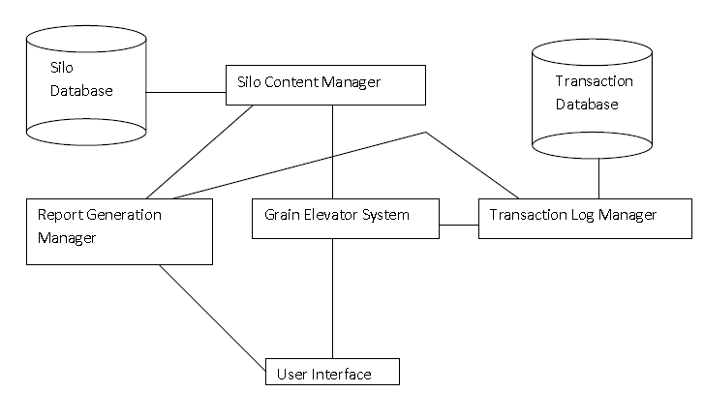
Candidate B Decomposition

Slide 7
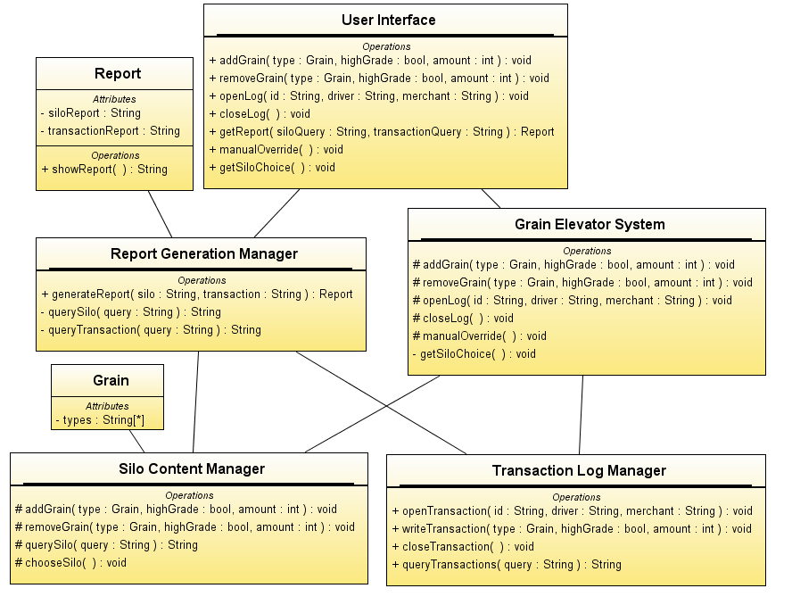
Candidate B Class Model

Slide 8
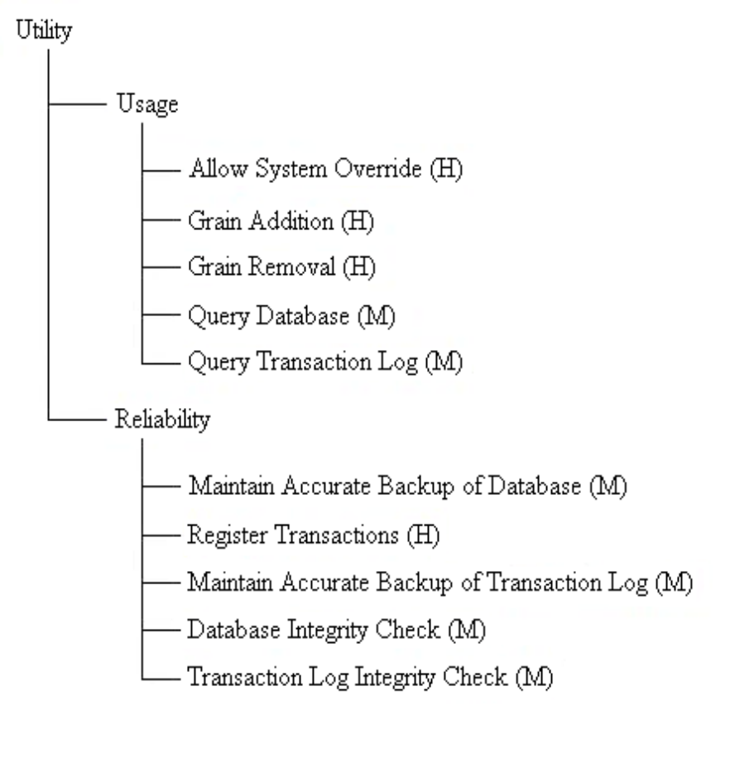
Utility Tree

Slide 9
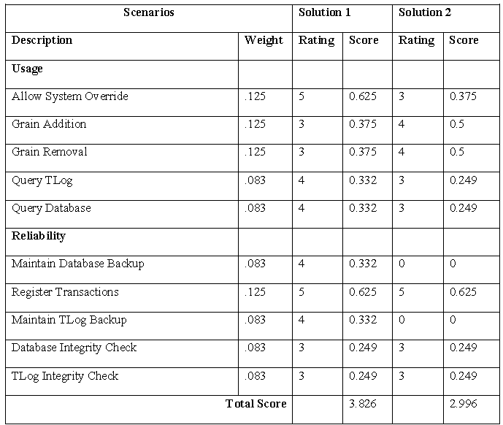
Scoring Matrix

Slide 10
Design Rationale
Candidate A is the better design solution because it generally supports all scenarios more effectively than Candidate B.
Candidate A implements a more delegated control structure as recommended in the Law of Demeter, and supports a higher level of information hiding.
Candidate A provides a greater level of performance by decreasing the number of instructions per access.

Slide 11
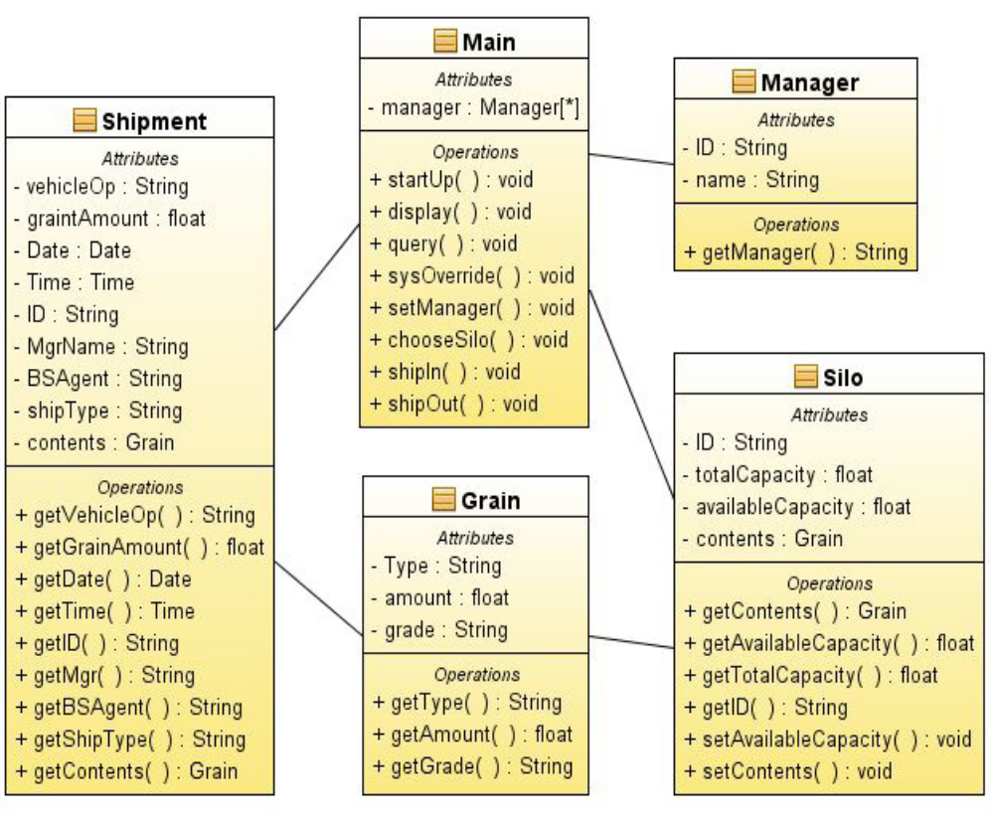
Detailed Class Diagram

Slide 12
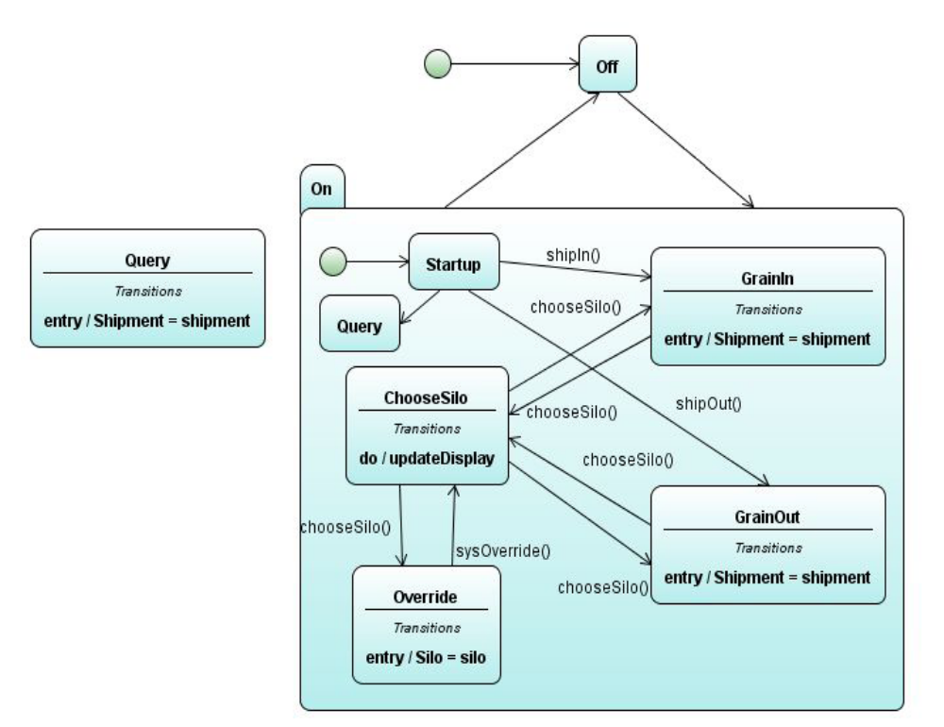
State Transition Diagram

Slide 13
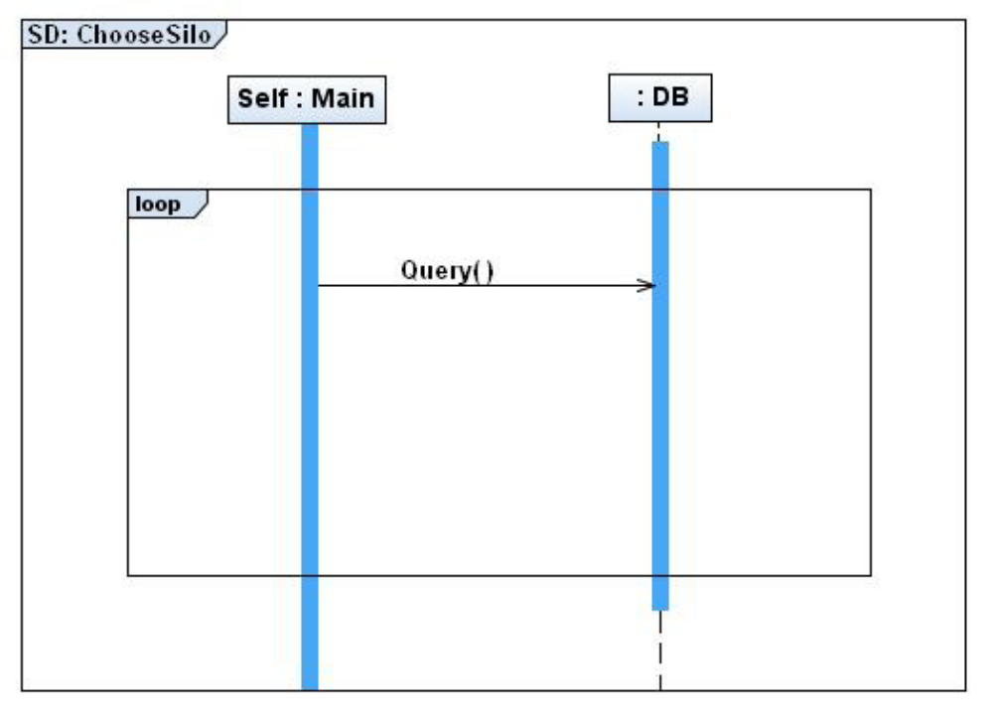
Sequence Diagram: ChooseSilo

Slide 14
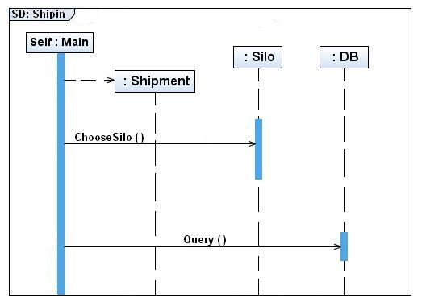
Sequence Diagram: Shipin

Slide 15
Prototype Demo
http://cljweb.byethost9.com/Grain/

Slide 16
Questions?

